Slide 1

Mini Reports with R

Slide 2
Set up R and R Studio
Set up R and R Studio
1
Gather Raw Data Files
2
Run Part 1
3
Create PDF
5
Run Part 2
4

Slide 3
Step 1: Set up R and R Studio
Download the Latest version of R and R Studio
Download R
Download R Studio
Download Java (or replacement, ask Integrity)
Learn some R using SWIRL or another online R learning tool
SWIRL Teaches you the basics of R in R Studio.
Learn: setting up a working directory, installing packages, etc.

Slide 4
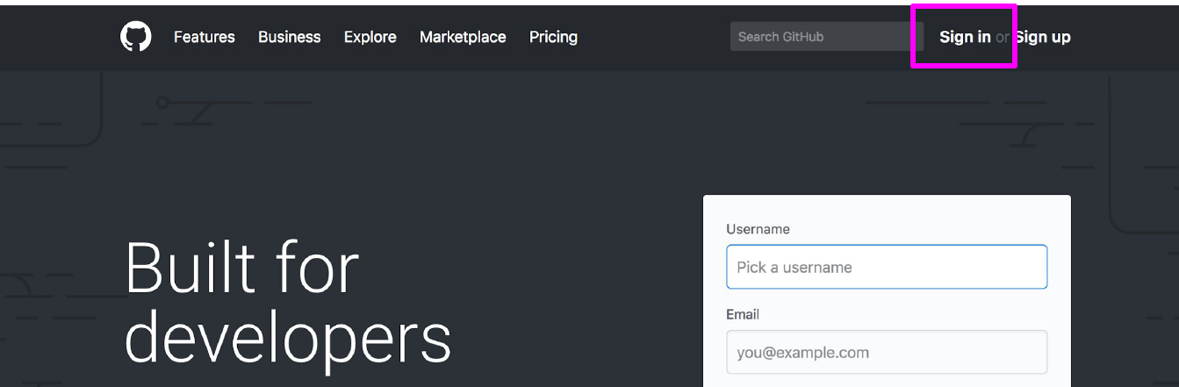
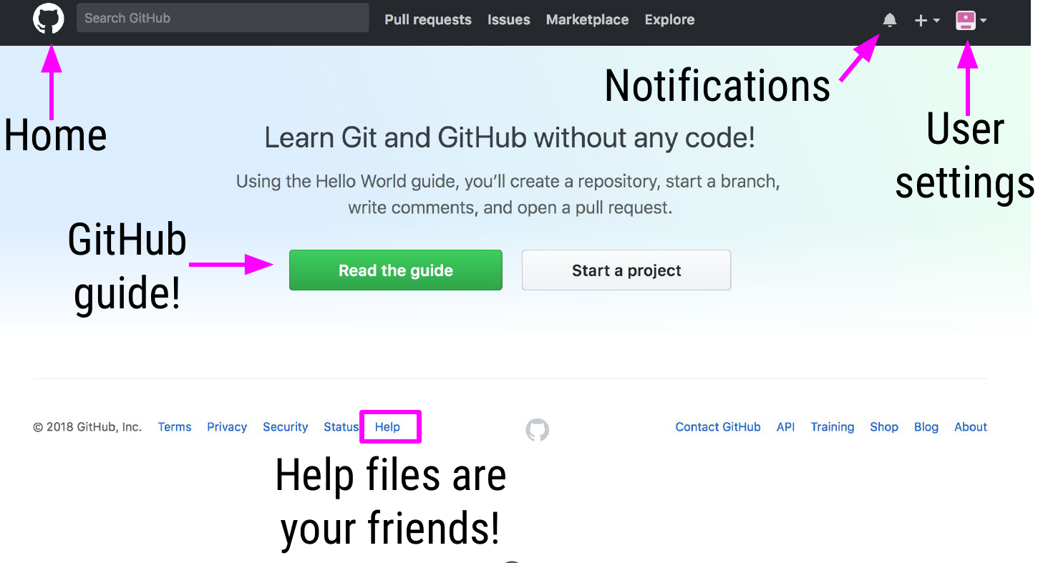
Step 2: Set up GitHub with R Studio
1. Sign up for an account at https://github.com/
2. Log in and get familiar with how GitHub works with the guide provided.

Slide 5
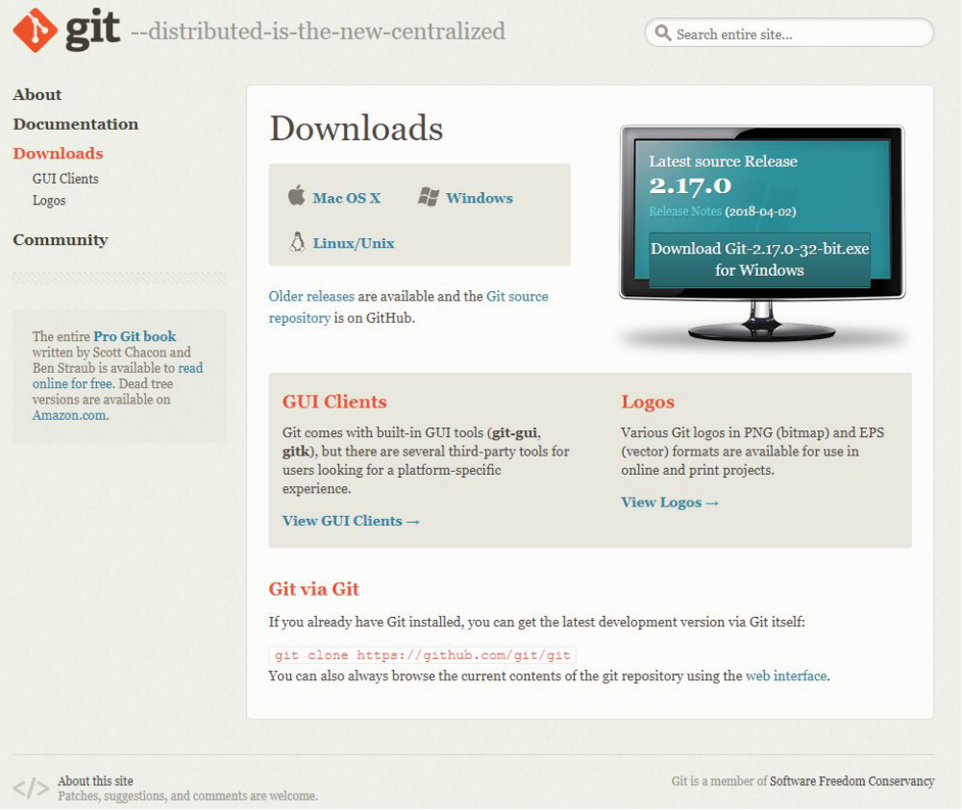
Step 2 : Set up GitHub with R Studio
3. Download Git from https://git-scm.com/download
Follow the setup wizard to have it downloaded onto your laptop
4. Open up R Studio to start the process of linking GitHub to your R Studio

Slide 6
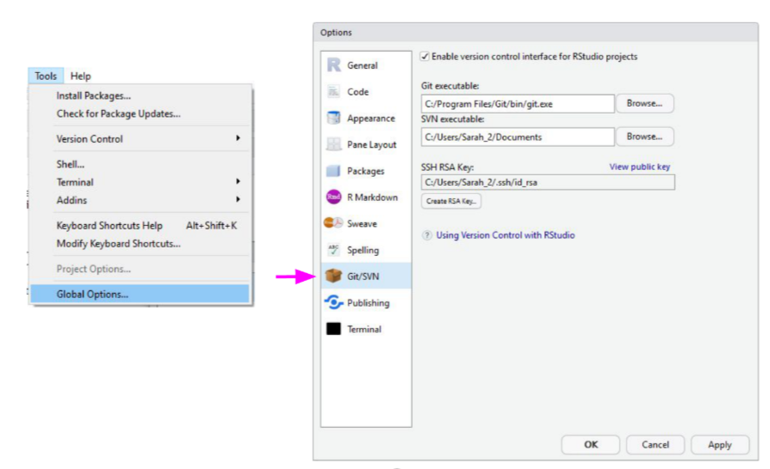
Step 2 : Set up GitHub with R Studio
5. In R Studio go to Tools>Global Options>Git/SVN
6. Click “Create RSA key”, once complete close the pop-up
7. Click “View public key” and copy the key onto your clipboard.

Slide 7
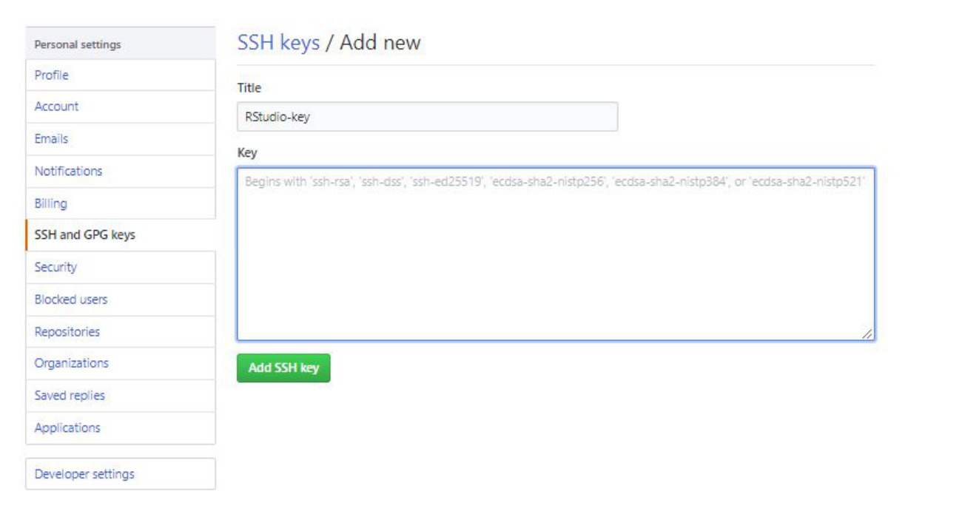
Step 2 : Set up GitHub with R Studio
8. Go back to your GitHub account and go to your account settings
9. Open the “SSH and GPG keys” tab
10. Click to add a new SSH key and paste the key from R-Studio into the box.
11. Save the new key to profile

Slide 8
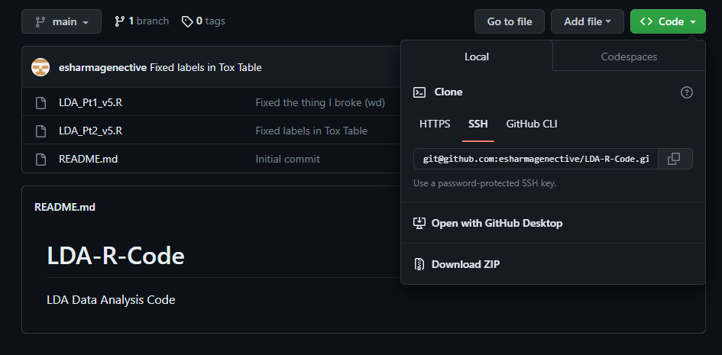
Step 3: Downloading R code from GitHub
1. Download the latest versions of the analysis software
Go to the GitHub Repository
Click on the “<> Code” menu
Copy the SSH key for this repository
** Make sure you are added as a collaborator to the repository first

Slide 9
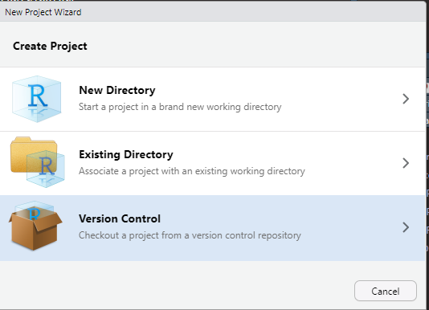
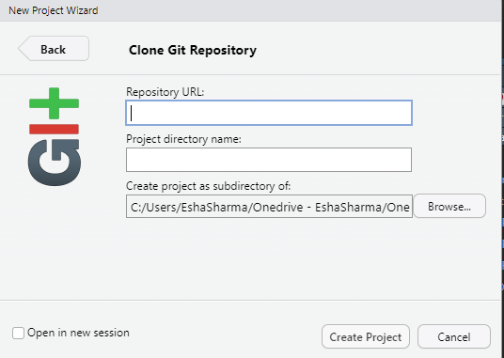
Step 3: Downloading R code from GitHub
2. Add the repository to your R Studio
Create a new project
Click Version control, and select Git
Paste they SSH Key from GitHub into the box
Make sure to select the location where you want the repository stored on your computer

Slide 10

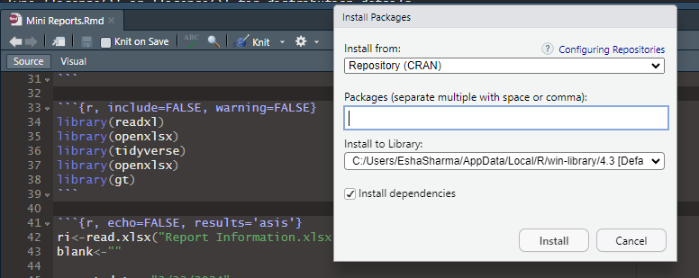
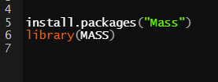
Step 4: Install Packages
Install packages
Open “Mini Reports P1.Rmd”
Near the top of the script there is a section that lists the libraries needed for the scripts to run.
Either use install.packages() to install each packages (below) or go to Tools -> Install Packages and type in the package names (right).
You will only have to install packages once, not every time you run the script.

Slide 11
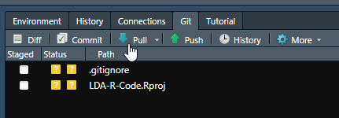
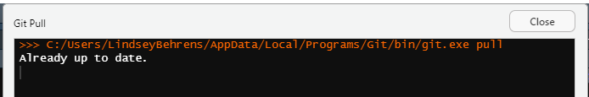
Step 5: Pull Latest Versions
In R Studio in the Environment Window, go to the Git tab and use the ‘Pull’ button to get the latest versions of the R scripts.
A message should pop up that tells you what updates were made or that you are all up to date.

Slide 12
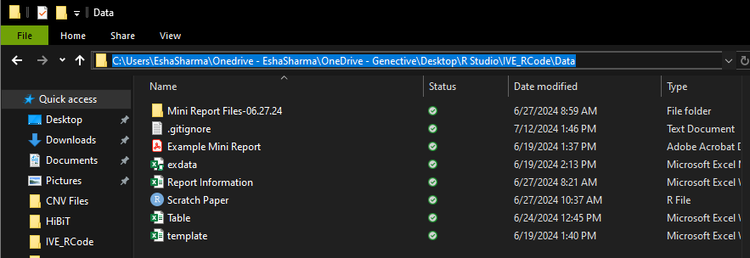
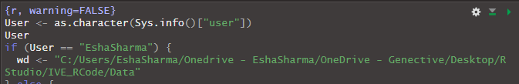
Step 6: Set up Working Directory
The working directory needs to be set up.
In the first chunk of code.
Change the location of the working directory to YOUR working directory.
Remember, for locations and working directories make sure to change the ‘\’ to ‘/’ otherwise R won’t read it.
Change the location of the folder that holds the raw data

Slide 13
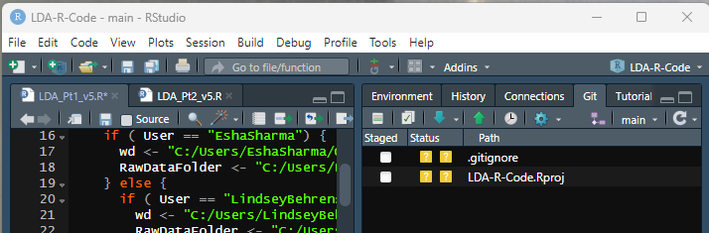
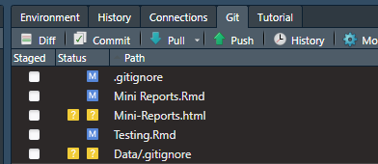
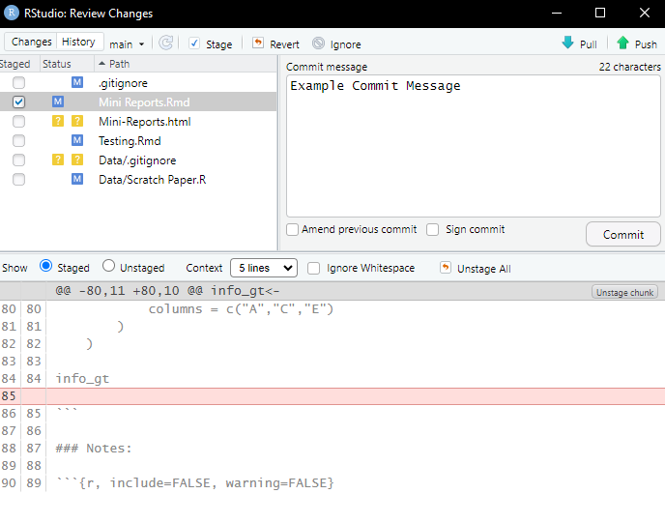
Step 6: Set up Working Directory
Save Both Scripts
The scripts will appear in the Git Tab
Check the box next to the script and click commit
In the new window, type in a descriptive commit message
For example, “added working directory”
Click commit
Click push at the top right.
Your new version will now be available to everyone.
4
6
9
8

Slide 14
Gather Raw Data Files
Set up R and R Studio
1
Gather Raw Data Files
2
Run Part 1
3
Create PDF
6
Run Part 2
5
Modify Files
4

Slide 15
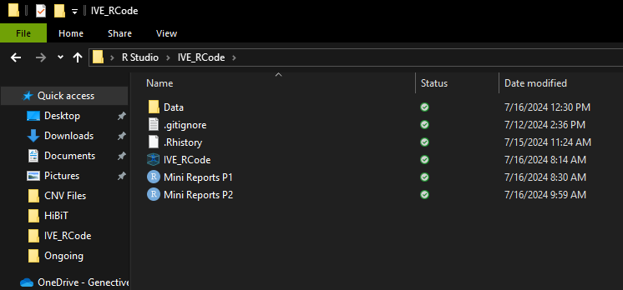
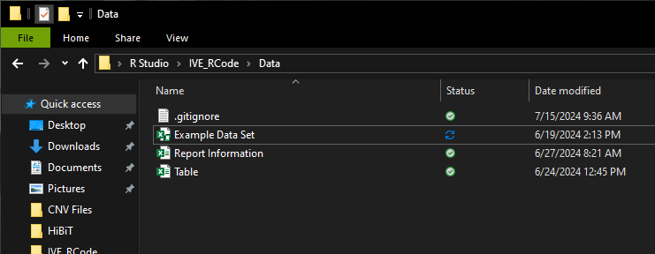
Step 2: Gather Raw Data Files
Create a copy of the Raw Data file
Move to the Data folder in the IVE_Rcode Project

Slide 16
Run Part 1
Set up R and R Studio
1
Gather Raw Data Files
2
Run Part 1
3
Create PDF
6
Run Part 2
5
Modify Files
4

Slide 17
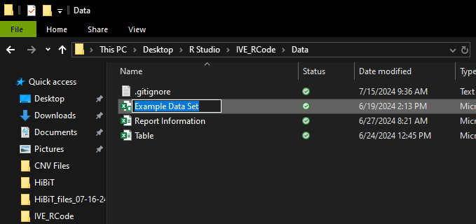

Step 1: Feeding in Info
Copy the name of the Raw Data file
Paste the name within the quotations where “exdata.xlsm” is
Make sure that the file type, “xlsm”, is not changed
1
2

Slide 18
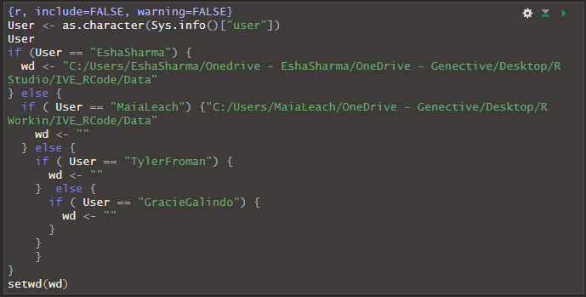
Step 2: Running the Script
2
Run the Set-Up chunks individually to ensure everything is in place correctly
Run by clicking on the green play button in the top right corner of the chunk
The first chunk needs to be run twice due to the RMD formatting rules

Slide 19
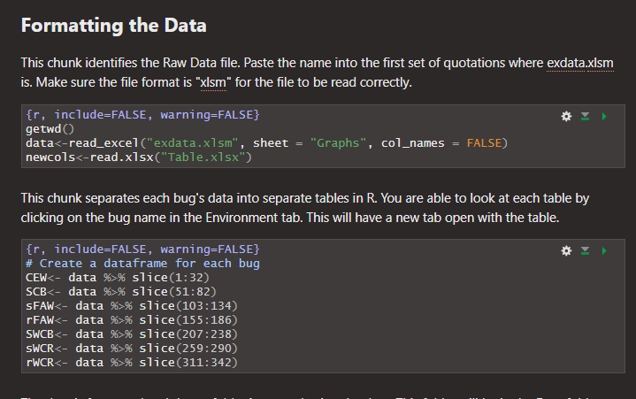
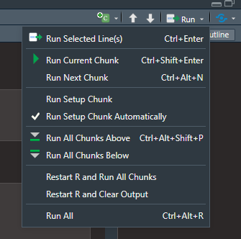
Step 2: Running the Script
You can run each chunk individually after the Set-Up chunks or run the whole script at once.
For individual: press the green play button in the top right corner of each code chunk
For all together: go to the Run menu in the top right corner of the window and click Run All
2
3

Slide 20
Modify Files
Set up R and R Studio
1
Gather Raw Data Files
2
Run Part 1
3
Create PDF
6
Run Part 2
5
Modify Files
4

Slide 21
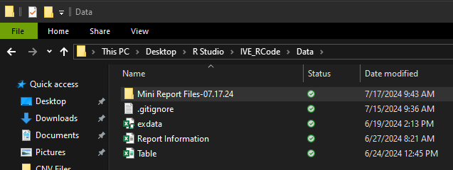
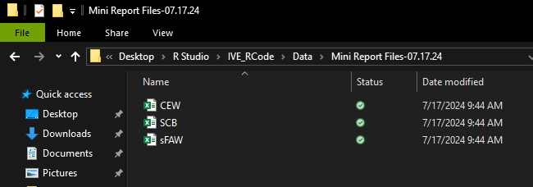
Step 1: Navigate to Files
Open File Explorer and navigate to the IVE_RCode folder
Enter the Data folder
There should be a new folder with the current date
Inside this folder are all the files the first part of the code has created
3
4

Slide 22
Step 2: Edit Files
Opening the specific bug file will show the table created
Do not edit anything in Row 1, the column headers, as this is what R uses to identify what column is what
Do not edit anything in column A or column S as that is used for identification and ordering the data
Any of the columns B-R are able to be edited from Row 2 and down
Most likely the columns that may need edits will be columns B, K, and L which are “Sample”, “Description”, and “Dose”
If any of the data in columns C to F is wrong please return to the original Raw Data file to change so the new summary stats can be calculated

Slide 23
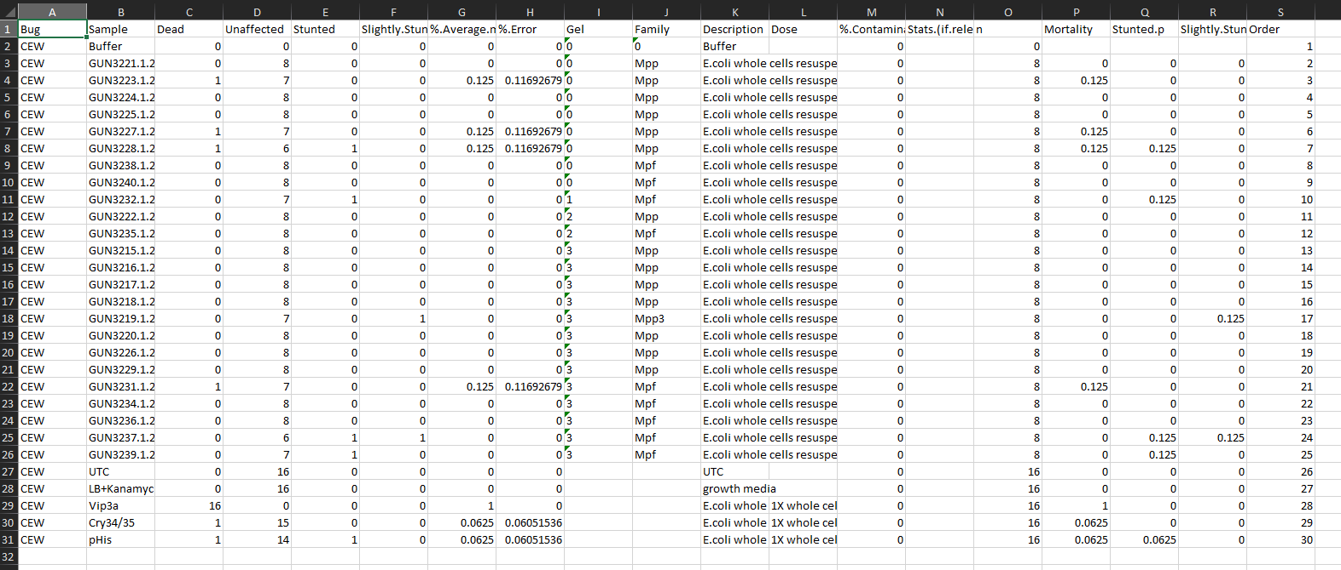
6
3
5
5
5
3
2
4

Slide 24
Run Part 2
Set up R and R Studio
1
Gather Raw Data Files
2
Run Part 1
3
Create PDF
6
Run Part 2
5
Modify Files
4

Slide 25
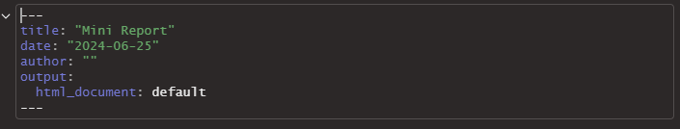
Step 1: Title
Enter in title, date, and author
Place all in between the quotations
Ensure there is a space between the colon and the first quotation mark
3
1
2

Slide 26
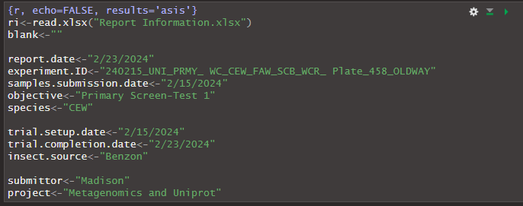
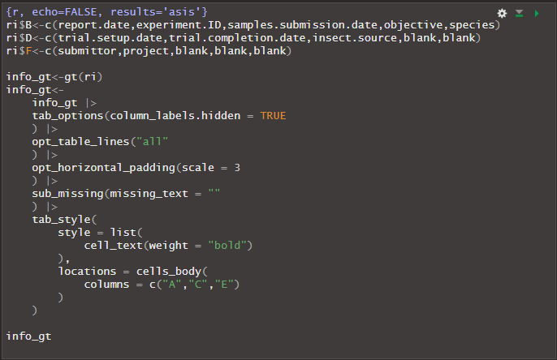
Step 2: Report Information
4a
3
Fill in the report information
Each label is directly pulled from the regular table set up
If the Experiment ID is too long, insert a space where appropriate for there to be a start of a new line
For a preview, press the green play button in the top right corner of this chunk and the following chunk to view the table
2
1
4b

Slide 27
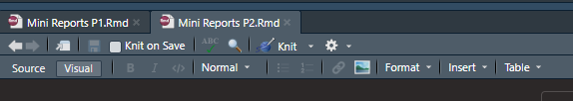
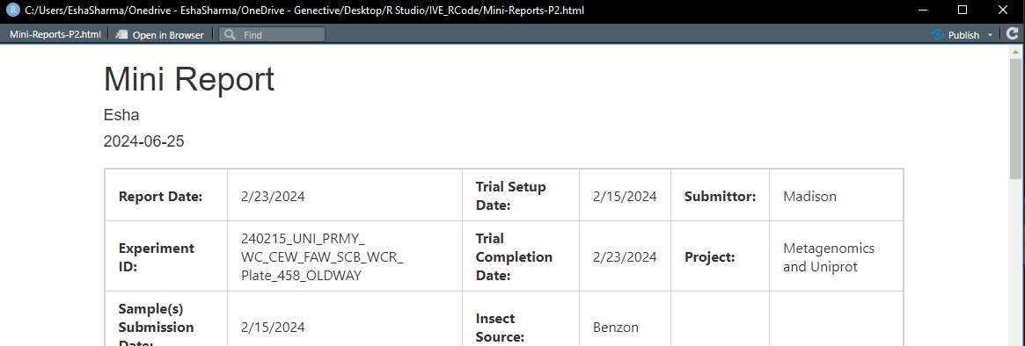
Step 3: Knit the Report
Navigate to the top left corner of the window and click Knit
This will create an .html file which will open in a pop-up window
This file is stored in the IVE_RCode project folder under the name Mini-Reports-P2.html

Slide 28
Create PDF
Set up R and R Studio
1
Gather Raw Data Files
2
Run Part 1
3
Create PDF
6
Run Part 2
5
Modify Files
4

Slide 29
Step 1: PDF
Search an online program that will convert an .html file to .pdf
Upload the file onto the program and download the new version that is in the .pdf format and save it wherever is appropriate
Ensure you do this before running a new report, a new report will overwrite the .html report with the new one

Slide 30
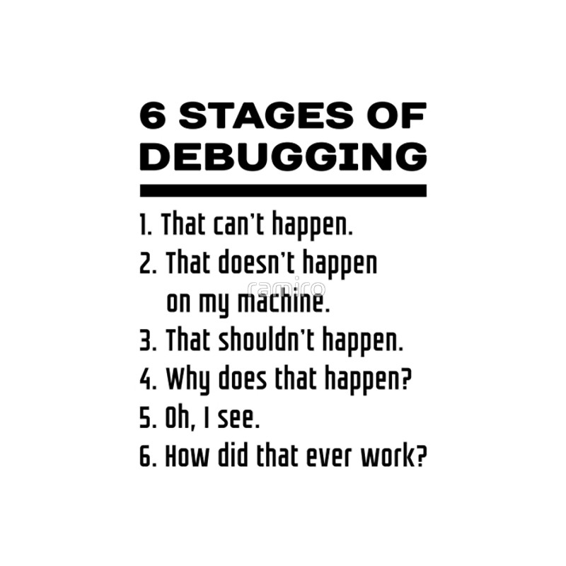
Troubleshooting R
“If debugging is the process of removing bugs, then programming must be the process of putting them in.”
-some dude on Reddit

Slide 31
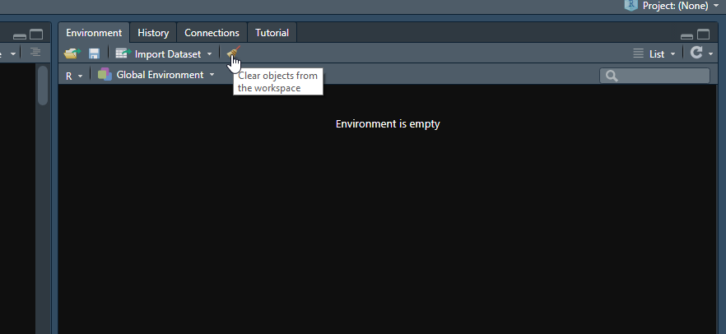
Basic Troubleshooting
Is your working directory correct?
Is the file name exactly correct? (case sensitive)
Are all your packages installed?
If you run line by line, where is the error occurring?
When you try to re-run the script make sure to ‘sweep’ the objects from your Environment so that old stuff doesn’t interfere with your new run.
Consult with Esha or Maia for any errors that may pop up

